Slide 1


Advertisement #1 Advertisement #2

Slide 2

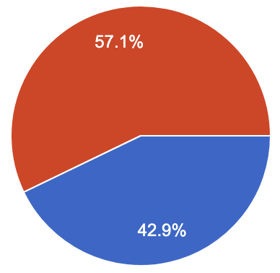
1 2

Slide 3
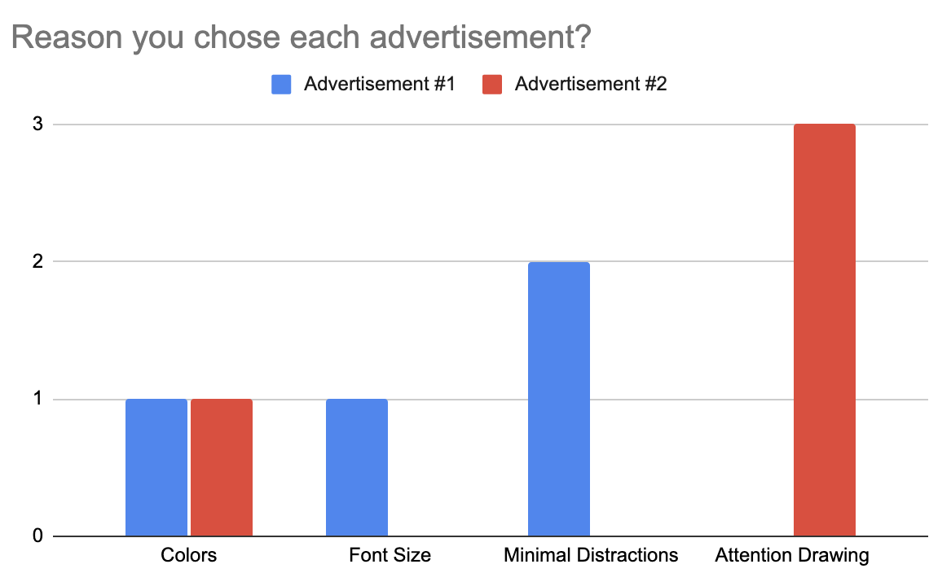
1
2

Slide 4
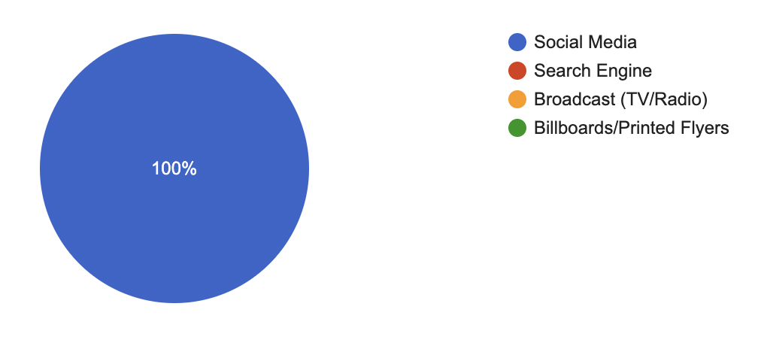
What type of advertisements do you typically interact with most?

